Slide 1

Introduction to convolutional neural networks

Slide 2
Convolutional Neural Networks are…
…A Special kind of Deep Neural Networks

Slide 3
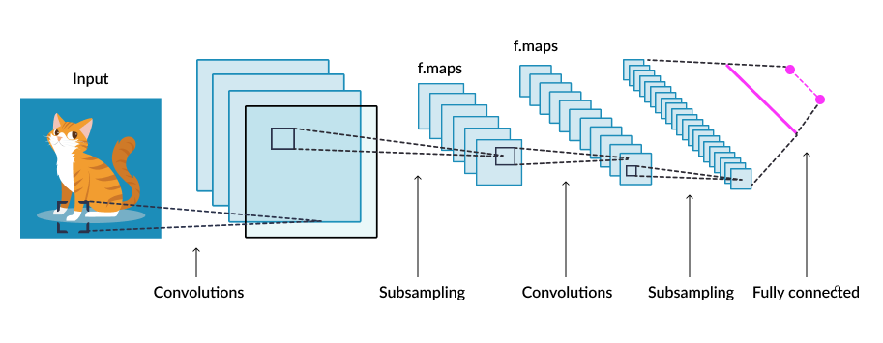
Convolutional Neural Network
Used for Image Pattern Classification
Feature Maps

Slide 4
What is a convolution?

Slide 5
1D Continuous Convolution - Definition
Convolution is defined as follows:
Convolution is commutative

Slide 6
Example (cont’d)

Slide 7
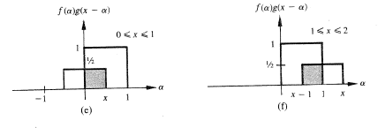
Example (cont’d)

Slide 8
Example (cont’d)

Slide 9
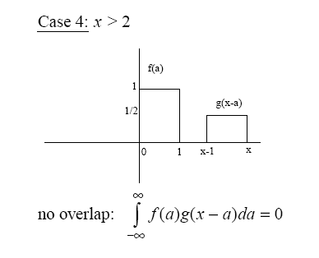
Example (cont’d)

Slide 10
Example (cont’d)

Slide 11
2D Convolution
Same as correlation except that the mask is flipped both horizontally and vertically.
Consider an image convolution example…

Slide 12
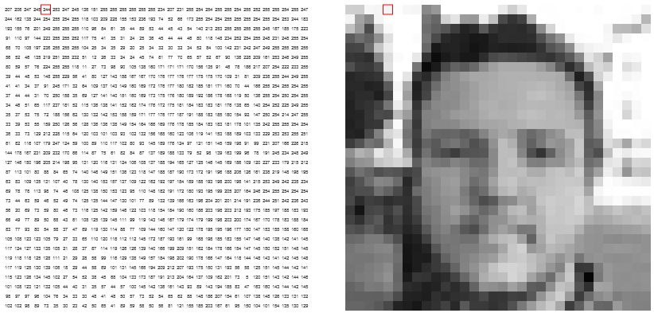
A sample image
http://setosa.io/ev/image-kernels/

Slide 13
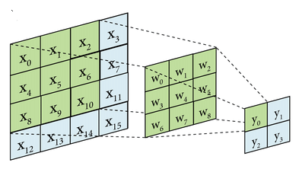

Slide 14
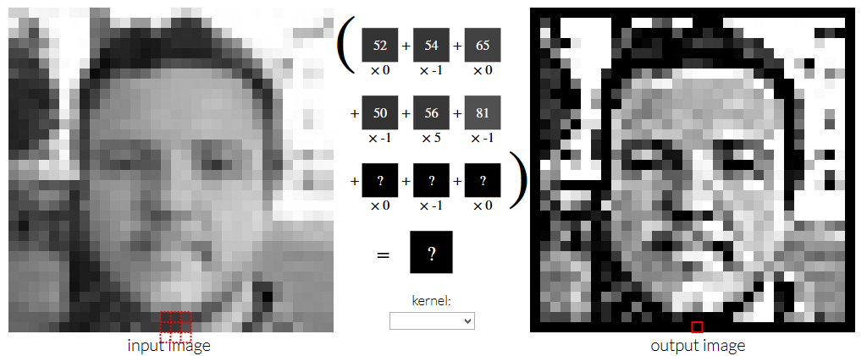
Convolution result
Convolution Kernel acts like an image filter

Slide 15
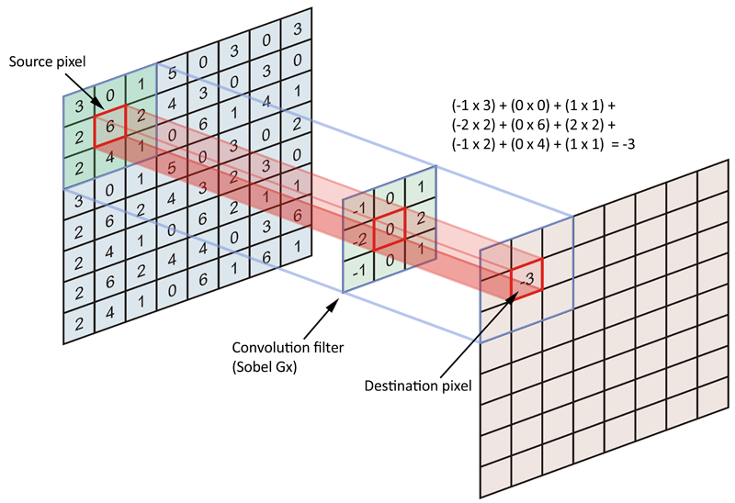
Image filter Example: Sobel Edge Detector

Slide 16
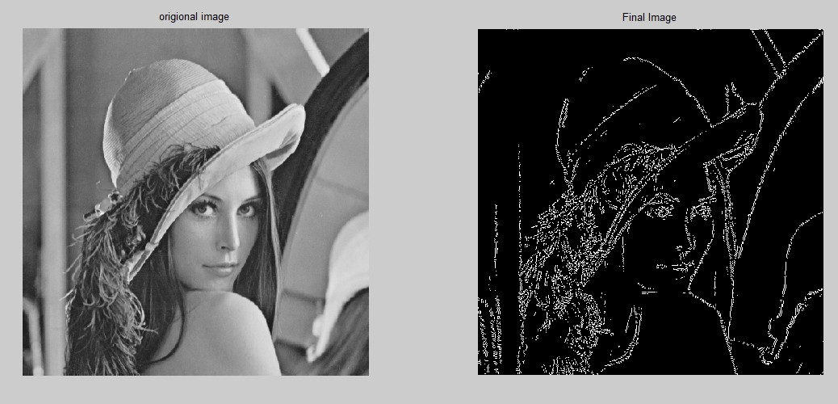
Sobel Edge Detector example

Slide 17
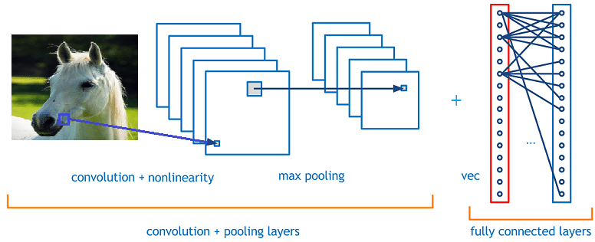
Convolution and Max Pooling stages

Slide 18

Max Pooling
Reduces Feature map Size

Slide 19
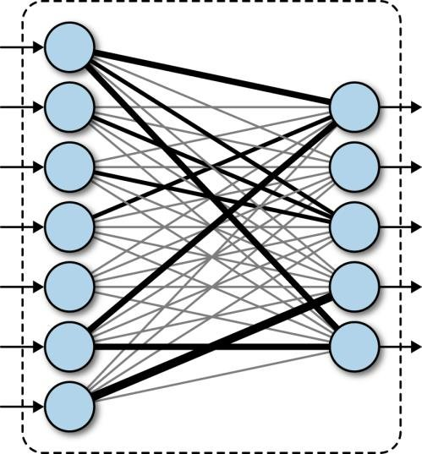
Fully Connected Layers

Slide 20
Multiple stages of Convolution and Max Pooling
Feature Maps

Slide 21
Summary
Has multiple paired stages of convolutional and max pooling stages
Convolutional stages (“Feature Maps”) are like image filters
Max pooling reduces feature map dimension
As we go to higher stages:
the number of feature maps increase
the size of individual feature map decreases
Neurons in higher stages have higher “Receptive Fields”
Neurons of the last hidden layer must be able to see the entire input image

Slide 22

Convolutional Neural Networks (CNNs) Handwritten Numeral Recognition
Lenet: Developed at AT & T to read zip codes on US postal envelopes
Speed: 10 chars/sec to 1000 char/sec
99% accuracy on test data at a rejection rate of 12%.
Inspired by biological visual system

Slide 23
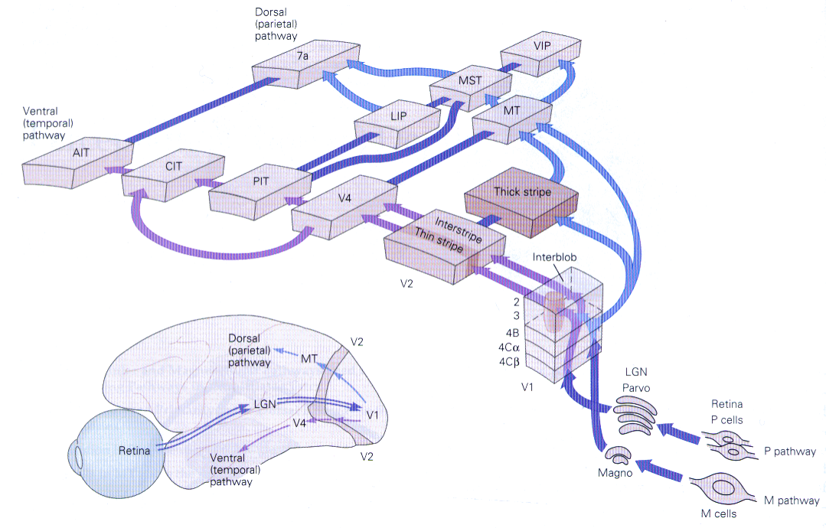
Human Visual System

Slide 24
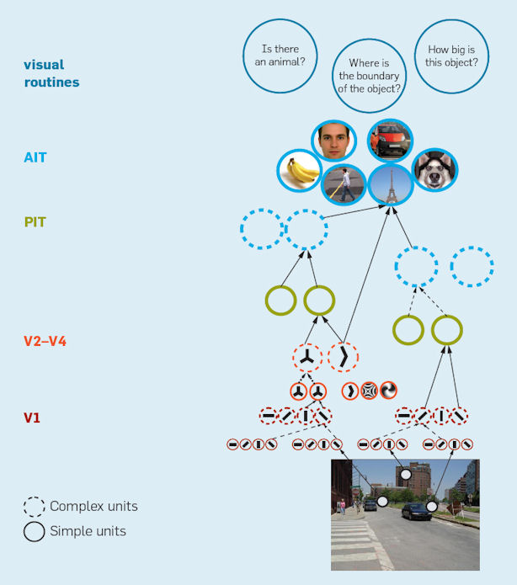
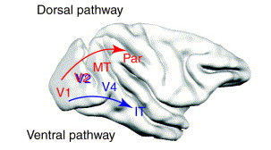
Hierarchical organization in the visual system

Slide 25


Slide 26
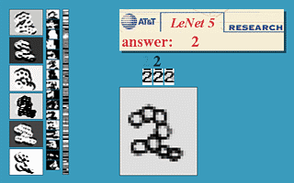
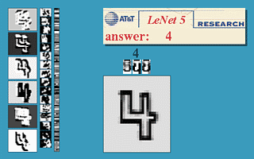
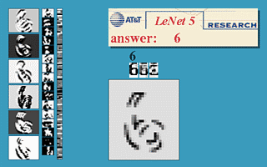
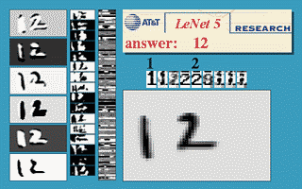
yann.lecun.com/exdb/lenet/

Slide 27
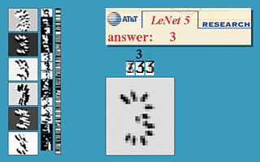
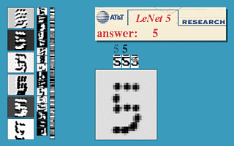

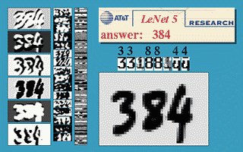
yann.lecun.com/exdb/lenet/

Slide 28
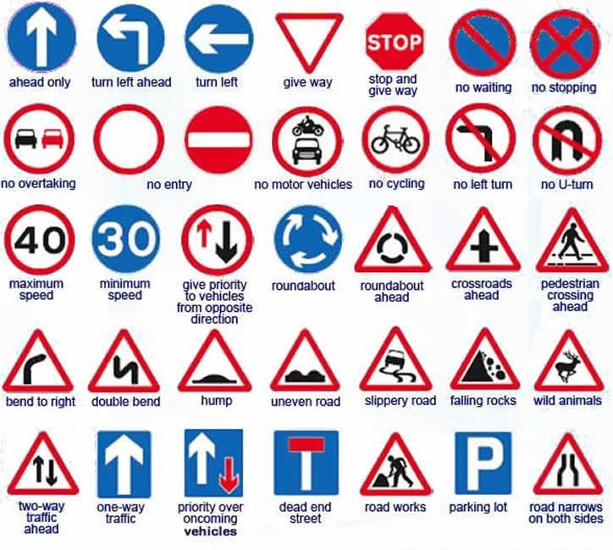
Traffic Sign Recognition
Multi-Column Deep Neural Network for Traffic Sign Classification (Ciresan et al 2011)
Winner of The German traffic sign recognition benchmark (GTSRB) (Stallkamp et al., 2011) challenge at IJCNN 2011.

Slide 29
Data
43 class classification problem
Training set: 39209 images
Test set: 12630 images
Each 48 X 48 pixels (color)

Slide 30
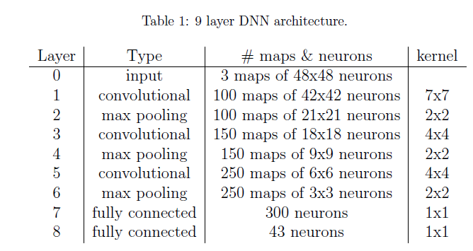
Deep Neural Network

Slide 31
Classifier

Slide 33
Performance
99.46% (best among all candidate algorithms)
Better than one of the humans (98.84%)
Makes 3 times fewer mistakes than the second best algorithm (98.31%)

Slide 34
Deep learning for Self-driving Cars
Uses CNNs to map the image from the front facing camera onto the steering angle
Can steer the car:
with or without lane markings
on both local roads and highways
can also operate in areas with unclear visual guidance
Parking lots or unpaved roads
(Bojarski et al 2016)

Slide 35

Hardware
NVIDIA DevBox
Torch 7 (machine learning software)

Slide 36
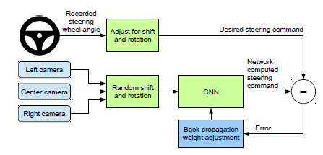
Training
(Bojarski et al 2016)

Slide 37
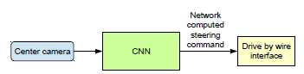
Testing/Using
(Bojarski et al 2016)

Slide 38
CNN Architecture
(Bojarski et al 2016)

Slide 39
(Bojarski et al 2016)

Slide 40
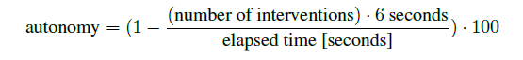
Simulator
Nearly 98% autonomy
(Bojarski et al 2016)

Slide 41
Responses of first layer feature maps to unpaved roads
(Bojarski et al 2016)

Slide 42
When there is no road in the image,
the features maps do not seem to pick up anything specific

